Slide 1
Next Generation Sequencing: intro
Wouter Bossuyt- 29/9/2020
RNAseq workshop

Slide 2
What’s the use of technology if it is not usable?

Slide 3
Mission
Make NGS accessible and serviceable for everybody
Reduce price of sequencing
NGS knowledge center
Diagnose patients
Diagnostics
±1500 projects/year
Research
±550 projects/year

Slide 4
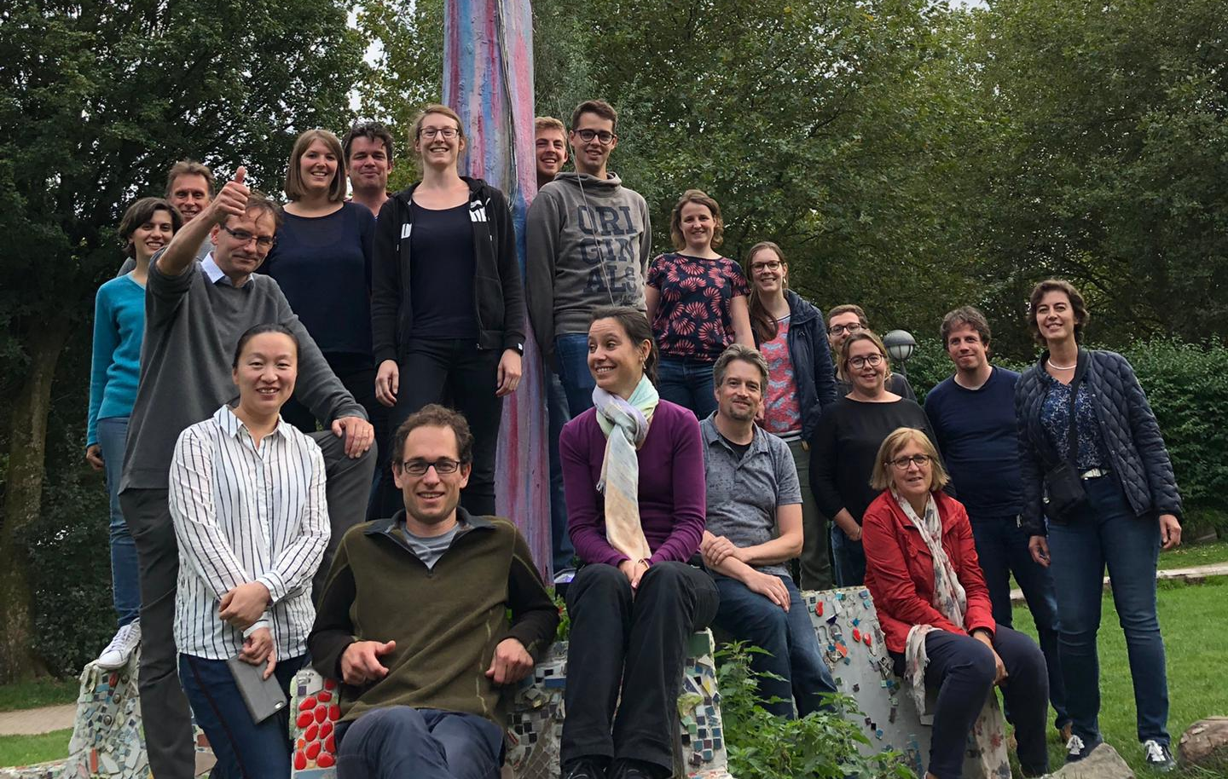
Our team

Slide 5
DNA
RNA
Single cell genomics
Amplicon
MIPs
de novo assembly
Bacterial WGS
Vertebrate WGS
Long read sequencing
Truseq stranded mRNA
Lexogen quantseq
IsoSeq (Pacbio)
DepArray
SMART-seq2
10x Genomics
Sequencing only
Bio-informatics services

Slide 6
DNA Sequencing – the next generation
NGS refers to non-Sanger-based high-throughput DNA sequencing technologies.
NGS technologies constitute various strategies that rely on a combination of
Library/template preparation
Parallel sequencing

Slide 7
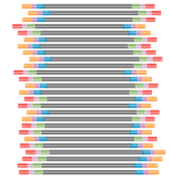
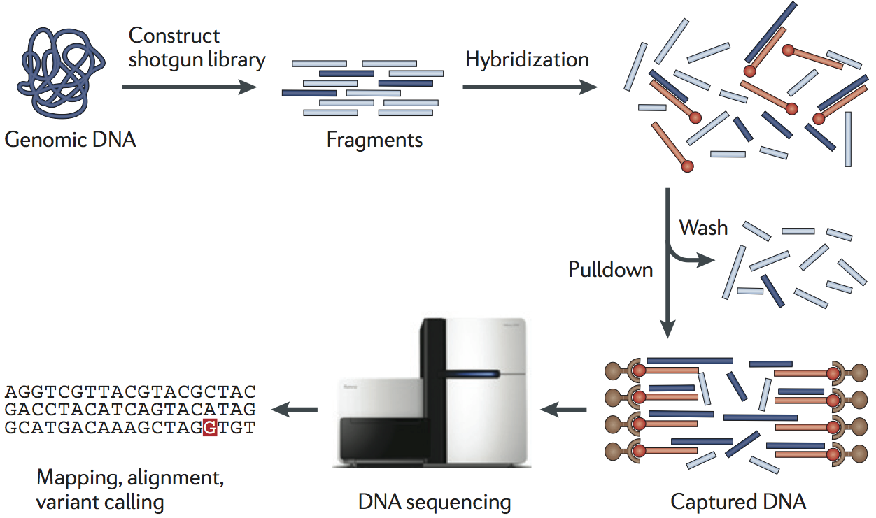

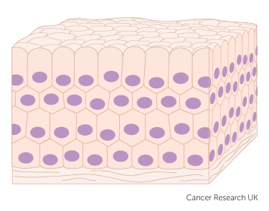
NGS workflow
RNA
cDNA
Library
Variant filtering & interpretation

Slide 8
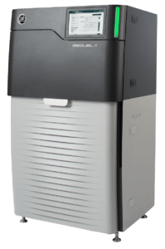
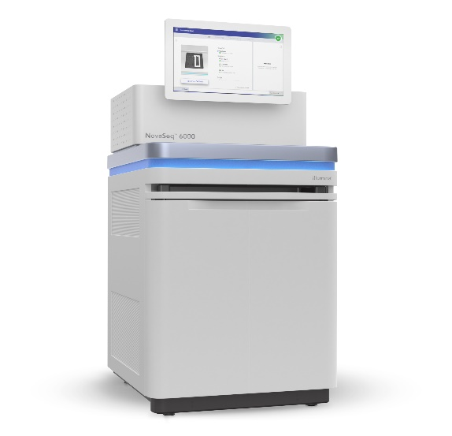
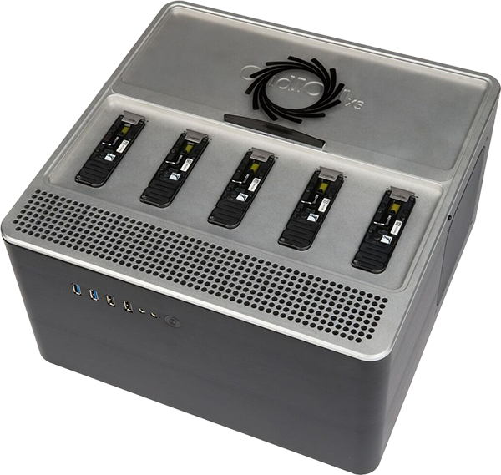
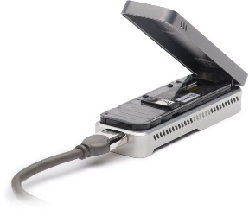
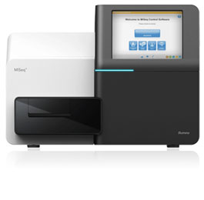
Two main types of NGS
Short read
Short, high throughput, cheap
Long read
Long, increasing throughput, more expensive

Slide 9


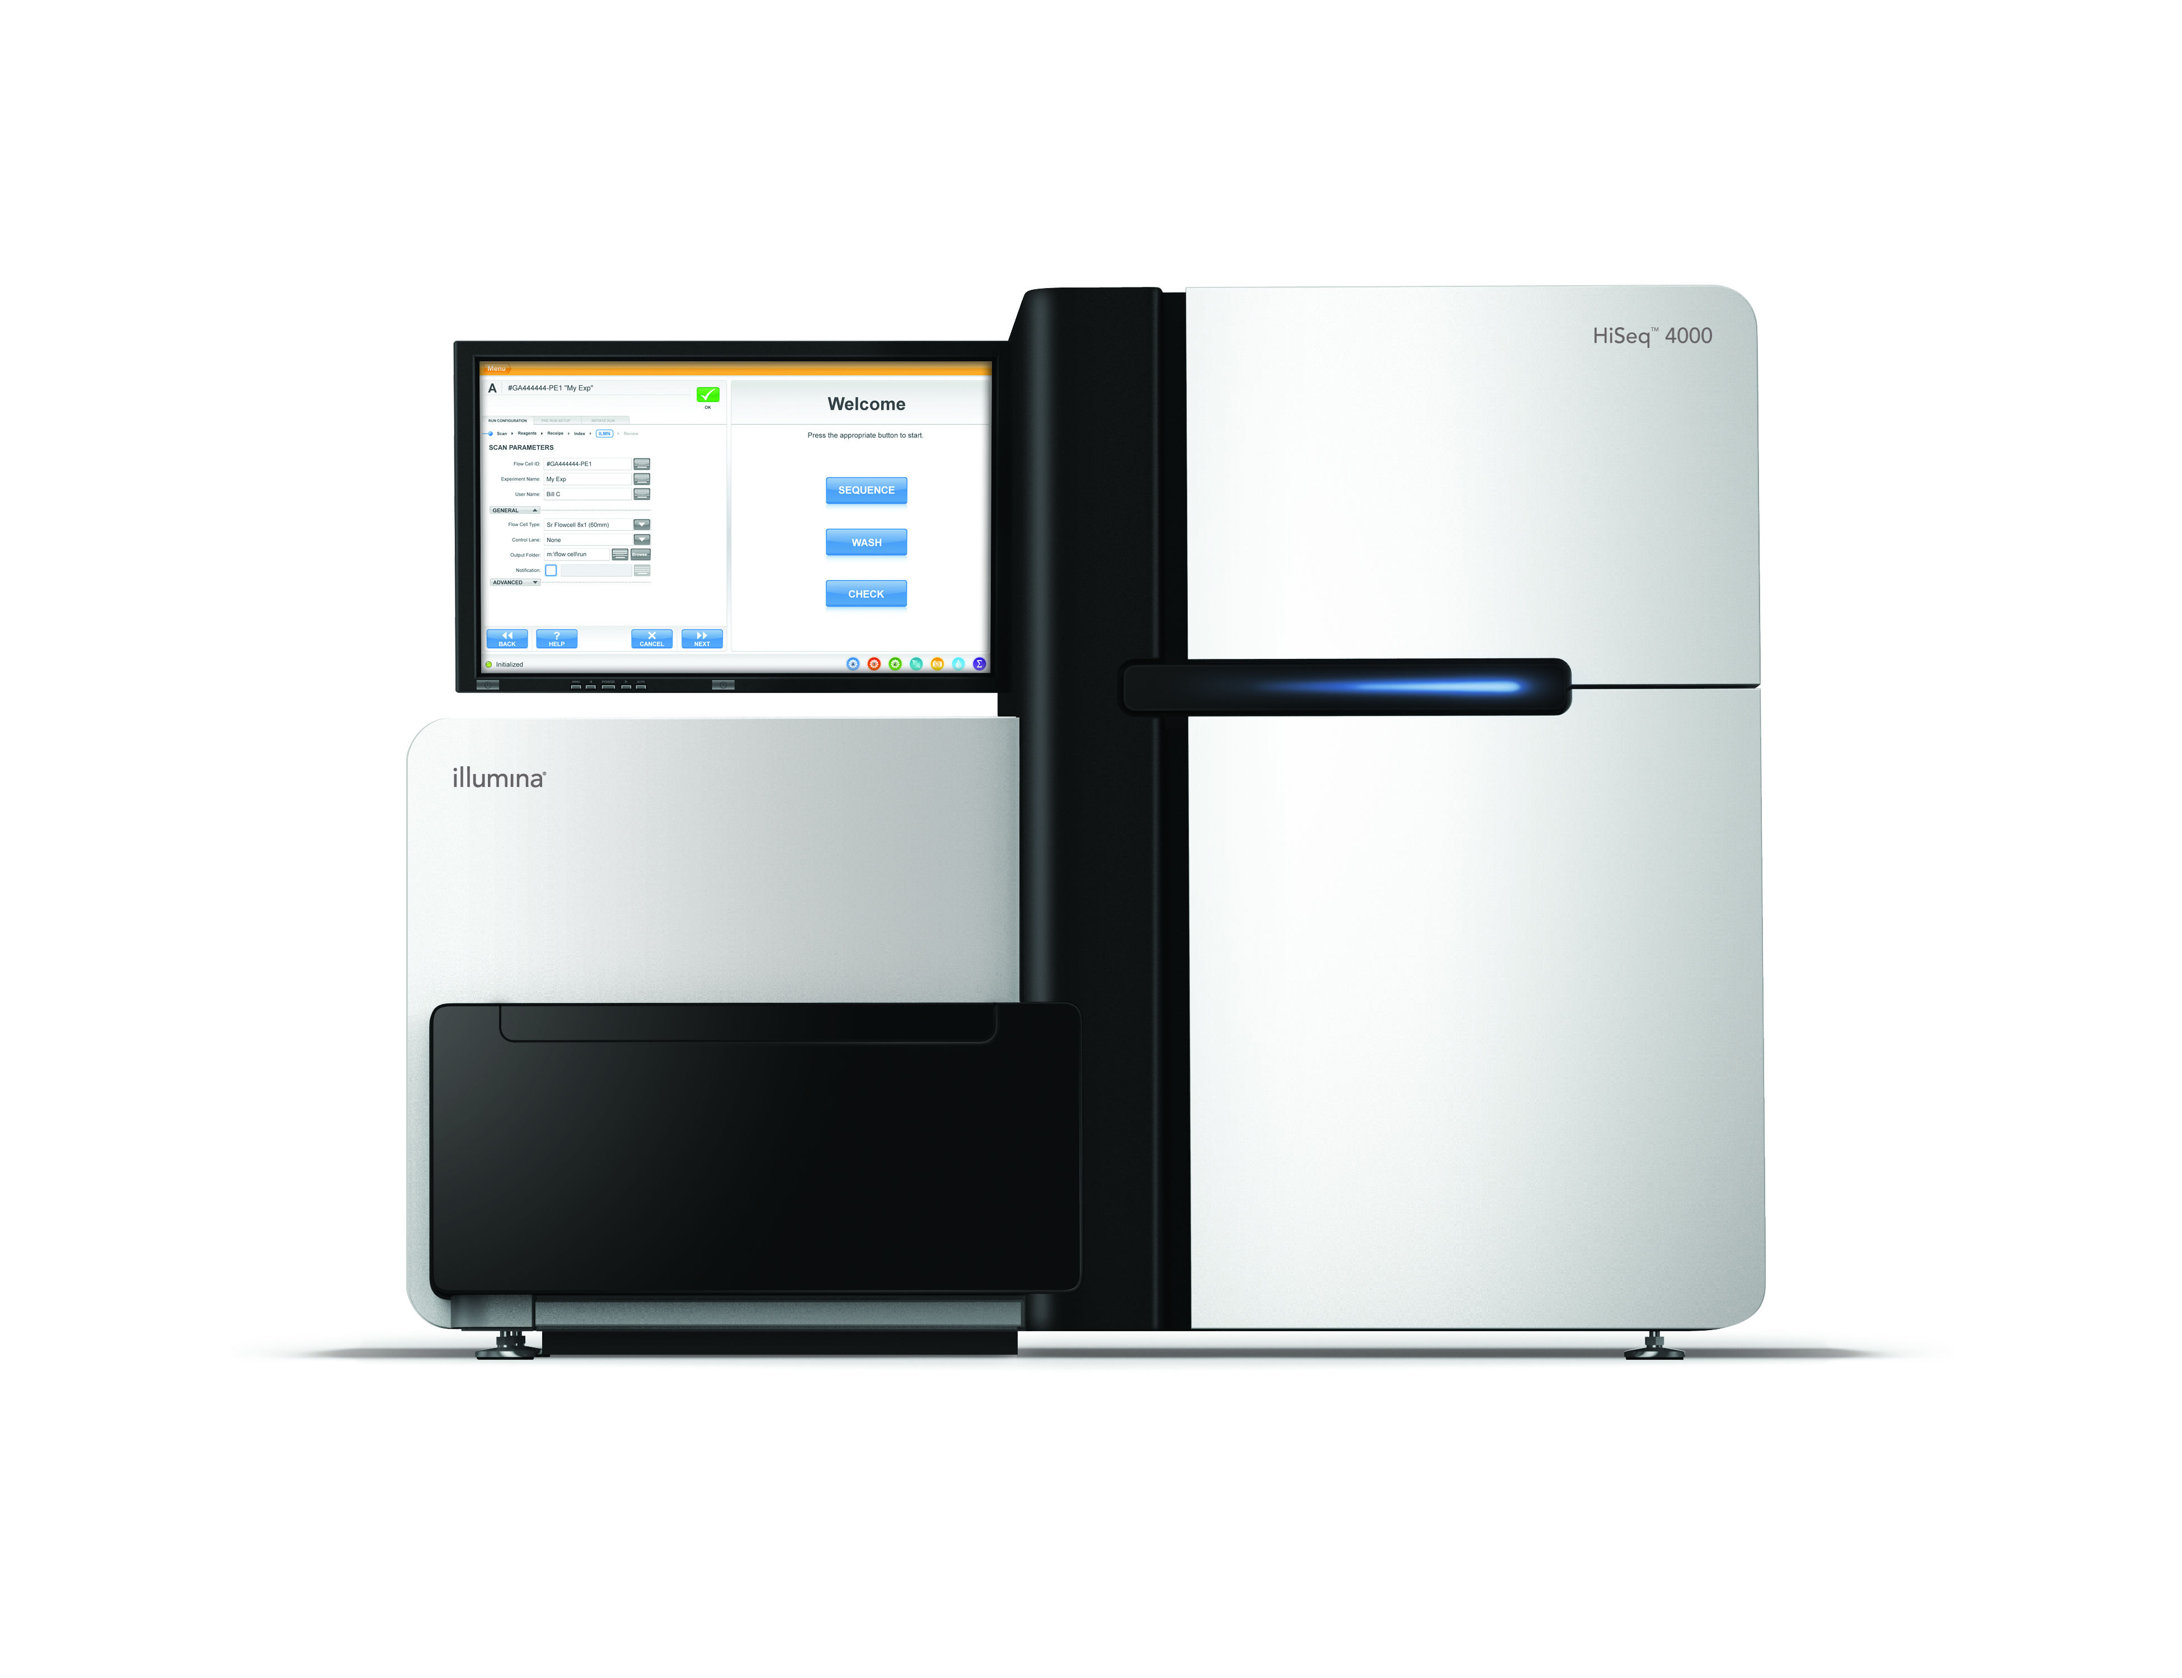
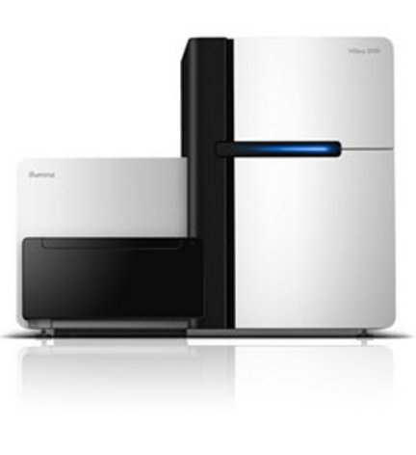
Illumina (solexa) sequencing
Illumina MiSeq, NextSeq 500, HiSeq2500, HiSeq4000 & NovaSeq 6000

Slide 10
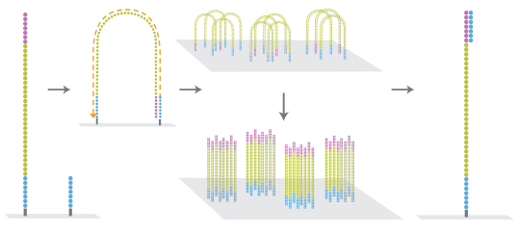
NGS Illumina Clustering
Clonal Amplification
Parallel sequencing
Sample prep

Slide 11
Clonal Amplification
Parallel sequencing
Sample prep

Slide 12
Clonal Amplification
Parallel sequencing
Sample prep

Slide 13
Clonal Amplification
Parallel sequencing
Sample prep

Slide 14
Clonal Amplification
Parallel sequencing
Sample prep

Slide 15
Clonal Amplification
Parallel sequencing
Sample prep

Slide 16
Clonal Amplification
Parallel sequencing
Sample prep

Slide 17
Clonal Amplification
Parallel sequencing
Sample prep

Slide 18
Clonal Amplification
Parallel sequencing
Sample prep

Slide 19
Clonal Amplification
Parallel sequencing
Sample prep

Slide 20
Clonal Amplification
Parallel sequencing
Sample prep

Slide 21
Clonal Amplification
Parallel sequencing
Sample prep

Slide 22
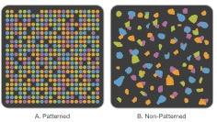


Flow Cell - Clusterdensity
Clonal Amplification
Parallel sequencing
Sample prep
Non-Patterned FC
Patterned FC

Slide 23
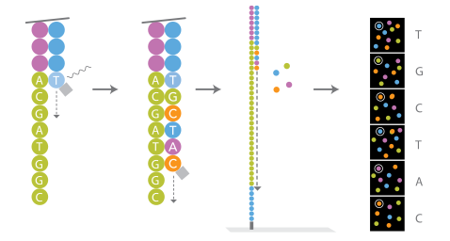
NGS Illumina Sequencing
Clonal Amplification
Parallel sequencing
Sample prep
Sequencing By Synthesis (SBS)

Slide 24
NGS Illumina Sequencing
Clonal Amplification
Parallel sequencing
Sample prep
Single index sequencing

Slide 25
NGS Illumina Sequencing
Clonal Amplification
Parallel sequencing
Sample prep
Dual index sequencing

Slide 26
Long read sequencing
Detection of CNVs and SVs
de novo assembly of genomes
Sequencing in repetitive and/or complex regions
Sequencing native DNA strand (with modifications)

Slide 27
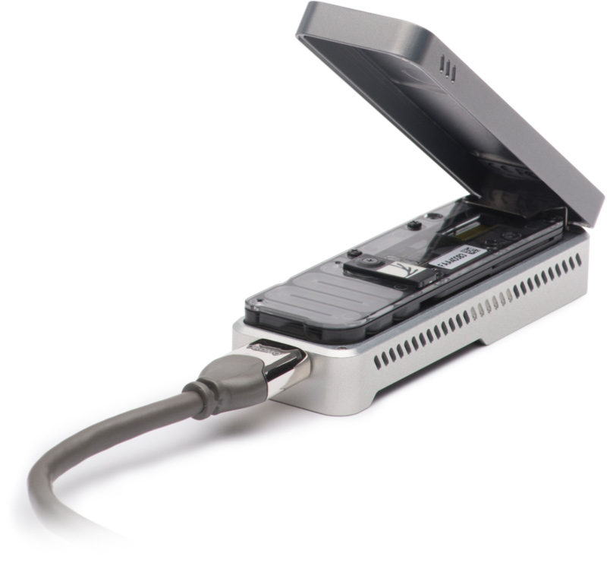
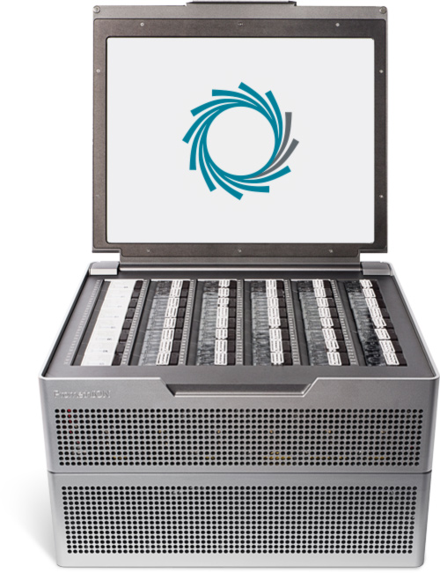
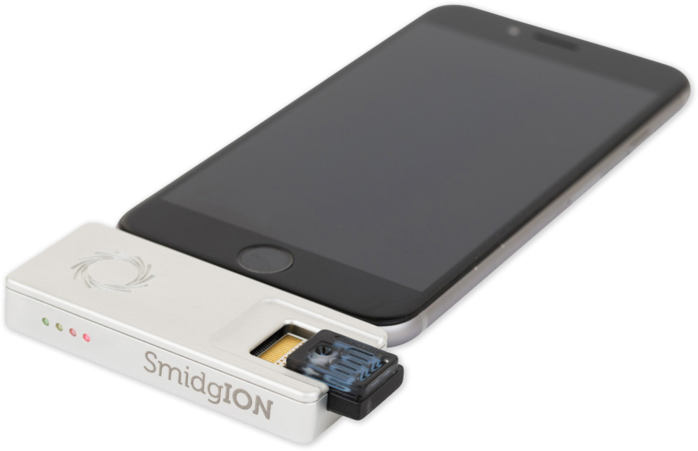
Nanopore sequencing
MinION
GridION
PromethION
SmidgION

Slide 28

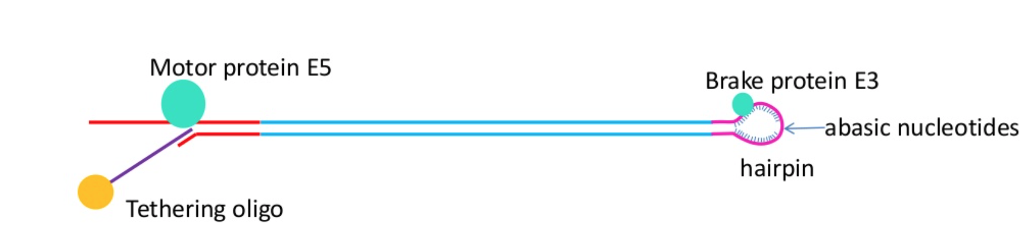
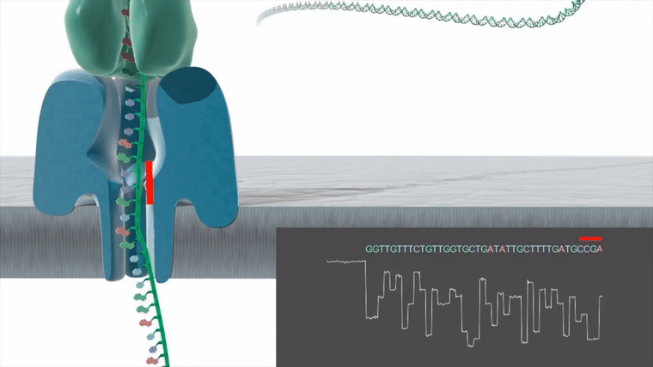
Oxford Nanopore sequencing

Slide 29
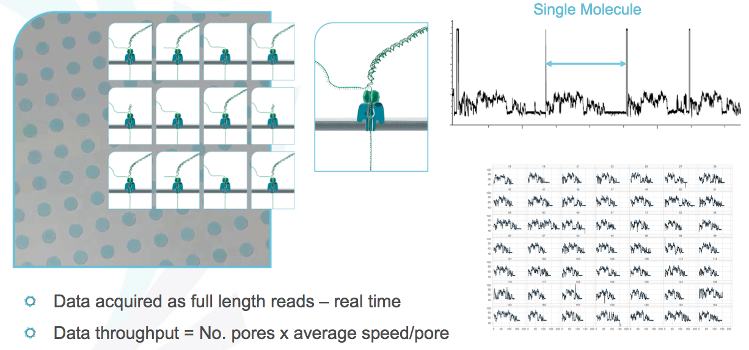

Slide 30

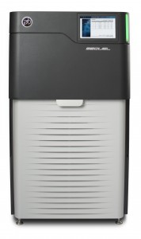
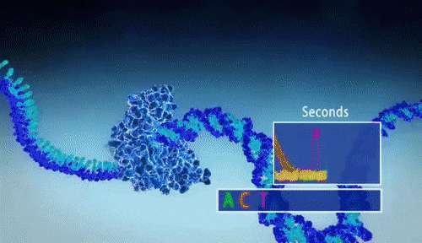
SMRT Sequencing
Pacific Biosciences PacBio Sequel

Slide 31
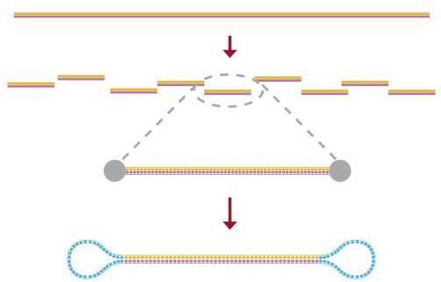
Template preparation
Template Preparation
Template Preparation
Run Design
Run Design
Polymerase Binding
Polymerase Binding
Instrument Run
Instrument Run
Primary Analysis
Primary Analysis
Secondary Analysis
Secondary Analysis
Tertiary Analysis
Tertiary Analysis
DNA Sample
Fragment DNA
Damage Repair/ End Repair
Ligate adapters
SMRTbell™ Template preparation can be used to create libraries of various insert sizes from 250 bp to 100 kb depending on the needs of the application.
Purify DNA
Notes:
The PacBio template preparation creates a structurally linear and topologically circular template. The SMRTbell Template can be used with a variety of sequencing protocols. A single streamlined protocol is used to create libraries of various insert sizes from 200 bp to 20,000 bp depending on the needs of the application. There is no need for routine amplification and only 500 ng of sample is required for libraries of 1 kb or smaller. Suitable sample types include: purified genomic DNA, BACs, cDNA libraries, and PCR products. The SMRTbell libraries are stable, and may be stored for up to six months after preparation.

Slide 32
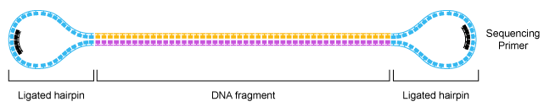
Advantages of SMRTbell™ Templates
Key Advantages:
Structurally linear
Topologically circular
Provides sequences of both forward and reverse strands in the same trace
Notes:
A SMRTbell template is a double-stranded DNA template capped by hairpin loops at both ends. The SMRTbell template is structurally linear and topologically circular. Key advantages of SMRTbell template format include homogeneous structure of the templates, efficient loading into ZMWs, and complementary strand information in every molecule. This enables us to apply essentially the same protocol to template generation at all size ranges. The hairpin adapters that are ligated to each fragment of DNA provide a common primer-binding site for the DNA polymerase. The common primer binding site further helps to reduce sequencing bias and normalize sequencing performance from inserts of different sizes.

Slide 33
Understanding Accuracy in SMRT® Sequencing
Single-pass error rate ~11% (predominantly deletions or insertions)
Single Molecule, Real-Time (SMRT®) DNA sequencing achieves highly accurate sequencing results, exceeding 99.999% (Q50)
How is this possible given that single-pass sequence has 1 mistake every 10 nucleotides
Single-pass errors are distributed randomly, which means that they wash out very rapidly upon building consensus.

Slide 34
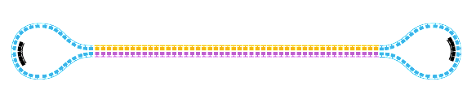

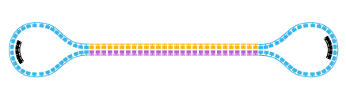
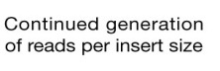
Universal SMRTbell™ Template
Large Insert Sizes
Generates one pass on each molecule sequenced
Recommended Insert Size: > 3 kb
Maximum length over 175 kb
Circular Consensus Sequencing (CCS)
Small Insert Sizes
Recommended Insert Size: 500 bp-20kb
Generates multiple passes on each molecule sequenced
Notes:
The SMRTbell template format can be used for standard continuous long reads and circular consensus sequencing. For standard sequencing, each SMRTbell template generates one pass on each molecule sequenced. At the other extreme, for smaller insert sizes the SMRTbell template allows multiple reads to be generated on each molecule. These can be combined together to generate a consensus read for each template.

Slide 35
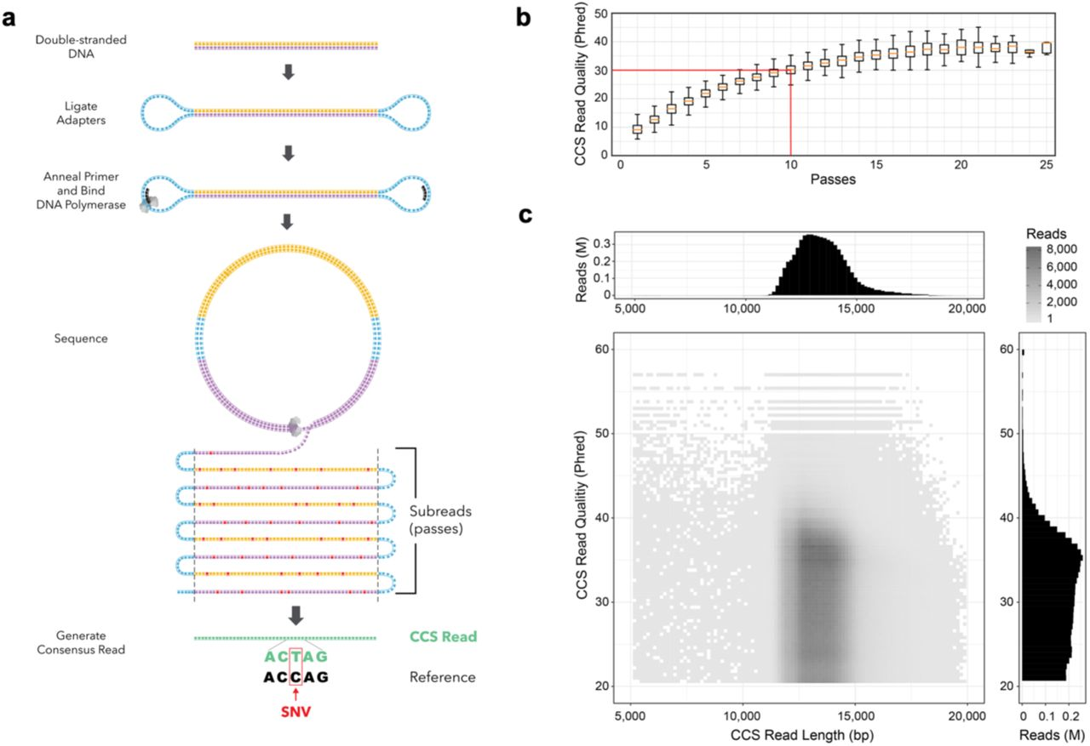
SMRT® Sequencing Accuracy
Notes:
SMRT® Sequencing provides greater than 99.999% (QV 50) accurate sequencing results for resequencing and de novo applications
independent of sequence context or GC content
Evaluation of any sequencing technology has three aspects (single-pass error not among those):
Consensus
Errors are random
No systematic errors
Sequence context bias
Negligible sequence context bias (high AT, high GC, repeat sequences, palindromes)
Mappability of sequence reads
Longest reads means highest quality genomes
Best mapping into repetitive regions
SMRT Sequencing has excellent performance in all three areas
Specific strains: E. coli K12, R. palustris, S. aureus USA300/TCH1516
Star represents point at which PacBio® reads aligned to reference with Quiver show perfect concordance with known reference. These would be 100% accurate, but QV score will ultimately be limited by genome size.
- E. coli has 0 variants compared to reference starting at 80X coverage
- S. aureus has 0 variants compared to reference starting at 60X coverage
- R. palustris still has 5 differences from the reference at 100X coverage. These may or may not be real errors.

Slide 36
Benefits of SMRT® Sequencing
Produce reads with average lengths of 6.000 to 30.000, with longest reads over 175.000 base pairs
Greater than 99.999% (QV 50) accurate sequencing results
Sensitivity to detect minor variants at frequency less than 0.1%
Detect broad spectrum of base modification events in the same sequencing run that reads canonical base sequence
No amplification bias and least GC bias for improved coverage uniformity
Notes:
Extraordinarily long reads: Produce reads with average lengths of 3,000 to 5,000 bp, with the longest reads over 20,000 base pairs.
Extremely high accuracy: Perform de novo assembly of genomes and detect variants with greater than 99.999% accuracy. Sequence individual molecules with 99% accuracy at greater than Sanger lengths.
Exquisite sensitivity: Detect minor variants that are present at a frequency less than 0.1%.
For research in epigenetics and methylation, the PacBio RS is the only commercially available system that can:
Discover a broad spectrum of DNA base modifications: Go beyond 5-methylcytosine and detect N6-methyladenine, N4-methylcytosine, DNA oxidative damage and other modified bases in the same sequencing run that reads the canonical base sequence.
Additionally, the PacBio RS offers:
Shortest run time: Sequence for as little as 30 minutes and still get reads longer than Sanger sequencing.
Least GC bias: Sequence through regions of extremely high or low GC content with ease, resulting in more even coverage.
No amplification bias: Samples need not be amplified, improving coverage uniformity and avoiding artifacts.

Slide 37
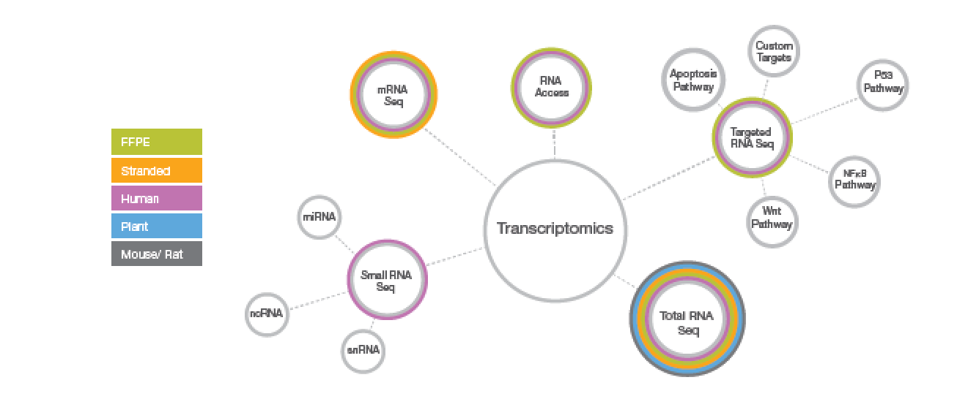
RNA SEQUENCING
Rapid expression profiling, transcriptome sequencing and small RNA’s

Slide 38
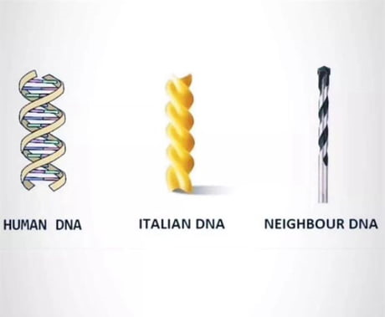
Thank you!

